Slide 1
Problem Solving
A reflection

Slide 2
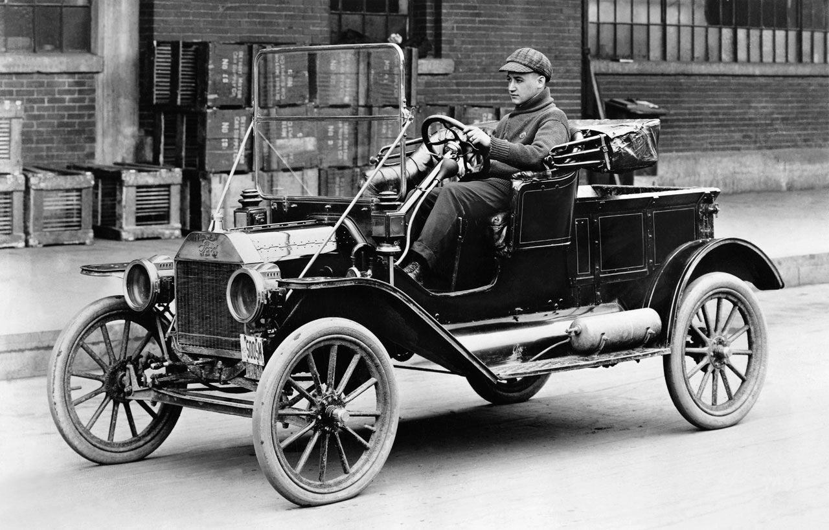
It's more than problem solving
It's a life skill.
Automotive leader Henry Ford’s first company went out of business. His second and third companies also flopped. Mr. Ford’s confidence was unscathed and he went on to become one of the greatest and most admired entrepreneurs in American history.

Slide 3
People have persevered to succeed
J.K. Rowling was a single mother on government aid. She couldn’t afford a computer or even the cost of making copies, so she manually typed out each version of her first book to send to publishers. It was rejected dozens of times until finally it was accepted
Stephen King was broke and lived in a trailer with his wife—also a write. They both worked multiple jobs to support their family while pursuing their craft. They were so poor they had to borrow clothes for their wedding and had gotten rid of the telephone because it was too expensive. He received 60 rejections before selling his first short story, "The Glass Floor," for $35.
https://www.themuse.com/advice/9-famous-people-who-will-inspire-you-to-never-give-up

Slide 4
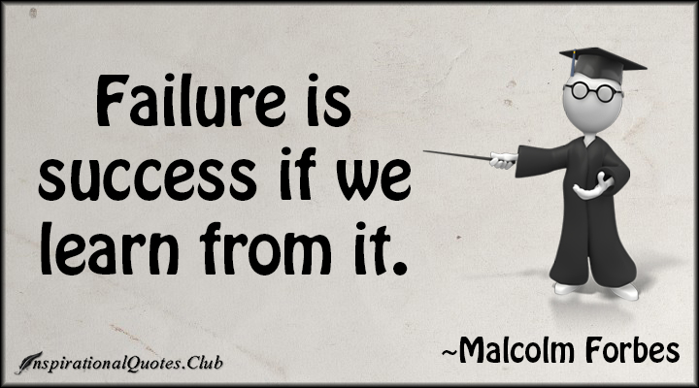
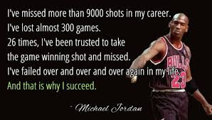

Slide 5
Don't let failure limit you!
Fail in order to learn from your mistakes
Fail in order to develop perseverance
Why it's OK to fail
It can be part of the pathway to success if you don't quit.
You Become Resilient
It Causes You to Evolve
What are your reactions when things don't work out easily?
Where are your strengths?

